Slide 1
Bipolar Junction Transistor (BJT)
Ref. Book: Electronic Devices and Circuit Theory - Robert L. Boylestad and Louis Nashelsky
Notes:
1
1

Slide 2
Transistors
Invented in 1948 by John Bardeen, Walter Brattain and William Shockley at Bell Lab
Transistors have replaced Vacuum tubes
Transistors offer several advantages
No heating is required, hence no delays and need less power
Small in size and light in weight
Require very low operating voltages
Consume less power and are operationally efficient
Long life and essentially no aging effect
Shock resistant
Notes:
2
2

Slide 3
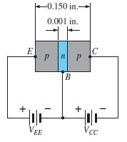
Transistor Construction
Bipolar Junction Transistor is a 3-layer semiconductor device consisting of
Either two “n” and one “p” type layers of material – npn Transistor
p
n
n
Or two “p” and one “n” type layers of material - pnp Transistor
Transistor has 3 regions: Base (B), Emitter (E), Collector (C)
Emitter emits or injects electrons (for npn) or holes (for pnp) into base.
Base passes most of these charge carriers (electrons/holes) to collector.
Collector gathers charge carriers from the base.
First Junction is called Emitter-Base Junction and 2nd junction is called Collector-Base Junction.
Width: Width of Emitter & Collector regions is much greater than the base region.
Ratio of the total width to width of the center layer is 150:1. Collector is physically larger than emitter region due too heat dissipation requirements.
Doping:
Base is lightly doped as compared to outer layers (1:10 or less) resulting in less conductivity (more resistance).
Emitter is heavily doped.
Doping of Collector is in between the heavy doping of emitter and light doping of base.
Notes:
3
3

Slide 4
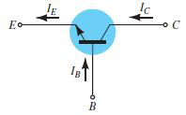
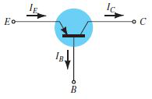
Transistor - Symbol
Bipolar Junction Transistor: Symbols used for representing npn and pnp transistors are as shown. In npn transistor, emitter has an outward pointing arrowhead.
npn
In pnp transistor emitter has an inward pointing arrowhead.
All current directions refer to conventional (hole) flow rather than electron flow. Thus arrows in all electronic symbols have a direction defined by this convention.
Therefore, the arrow in the diode symbol is defined by the direction of conduction/ conventional current.
In a BJT (Bipolar Junction Transistor) device holes and electrons participate in the injection process into the oppositely polarized material.
pnp
Notes:
4
4

Slide 5
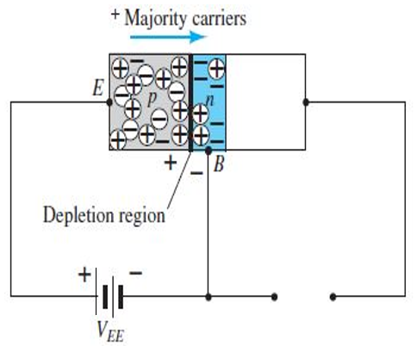
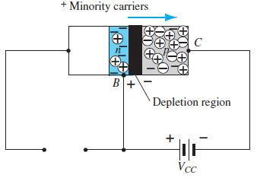
Transistor Operation
Basic operation of npn and pnp transistors is identical except that the roles played by the electrons and holes are interchanged.
One of the p-n junctions of the transistor is forward biased and the other is reverse biased.
Emitter-Base junction is forward biased, and has a narrow depletion region due to the applied bias, leading to heavy flow of majority carriers from the p - to the n -type material (for pnp transistor).
Emitter-Base junction is forward biased
Base-Collector junction is connected to power supply as per polarity shown in the diagram (with emitter base junction open):
This is akin to reverse biasing of B-C junction. Thus the flow of majority carriers is zero, resulting in only a minority-carrier flow.
Base-Collector junction Reverse Biased
Notes:
5
5

Slide 6
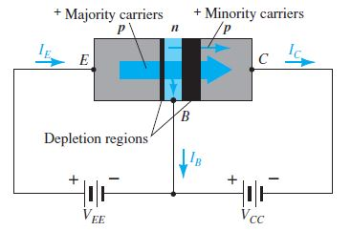
Transistor Operation
PNP transistor with biasing of both junctions and majority and minority carriers is shown.
Widths of the depletion regions indicates which junction is forward-biased and which one is reverse-biased.
A large number of majority carriers diffuse across the forward biased pn junction into the n -type base.
Since base region is very thin, lightly doped and has low conductivity, very small number of carriers will take high resistance path to the base terminal. → Thus base current is very low and is of the order of µAs, as compared to mAs for the emitter and collector currents.
Most of the majority carriers will diffuse across the reverse-biased junction into the collector region.
In the reverse-biased region these majority carriers appear as injected minority carriers in the n -type base region. Most of the minority carriers in the depletion region will cross the reverse-biased junction.
Notes:
6
6

Slide 7
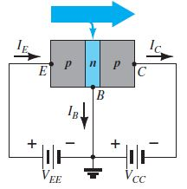
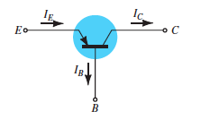
Transistor Operation
Applying Kirchhoff’s current law to the transistor
I_{E} = I_{C} + I_{B}
Collector current has two components first component is due to the majority carriers (I_{c majority}) and the second component is due to the minority carriers (I_{CO minority}).
I_{C} = I_{C majority} + I_{CO minority}
where I_{C} is measured in mA
I_{CO} is measured in µA or nA.
Minority-current I_{CO} is called the leakage current and is given the symbol I_{CO} ( Collector current I_{C} with emitter terminal Open).
I_{CO} , like reverse current I_{s} for a reverse-biased diode, is temperature sensitive. It can severely affect the stability of a system at high temperature.
Notes:
7
7

Slide 8
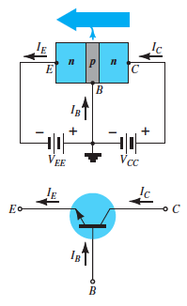
Transistor Operation
As mentioned earlier, Basic operation of npn and pnp transistors is identical except that the roles played by the electrons and holes are interchanged.
Here an npn transistors is shown, one of the p-n junctions of the transistor is forward biased and the other is reverse biased.
Emitter-Base junction is forward biased, and has a narrow depletion region due to the applied bias, leading to heavy flow of majority carriers from the n - to the p -type material (for npn transistor).
Collector-Base junction is reverse biased, and has a wide depletion region due to the applied bias.

Slide 9
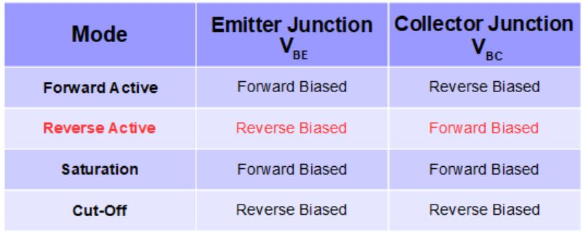
Modes of Operations of BJT
Active Mode - Most important mode of operation
- Central to Amplifier operation
- region where the current curves are practically flat
Saturation - Barrier potential of the junctions cancel each other out
causing a virtual short
Cut-Off - Current reduced to zero.
- Ideal transistor behaves like a switch
Reverse Active - Rarely used mode (Inverted Mode of Operation).
Notes:
9
9

Slide 10
Transistor Configurations
Notes:
10
10

Slide 11
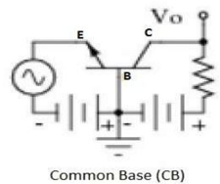
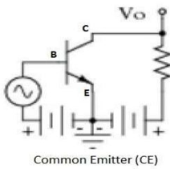
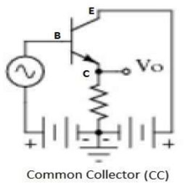
Transistor Configurations
There are three basic configurations:
Common Base (CB) Configuration:
Base terminal is common in input and output circuits.
Input signal is fed between emitter and base.
Output is taken between collector and base.
Common Emitter (CE) Configuration:
Emitter is common between input and output circuits.
It acts as an amplifier
Common Collector (CC) Configuration:
Collector is common between input and output circuits.
This is also referred as Emitter follower configuration.
CC provides high input resistance and low output resistance feature.
Notes:
11
11

Slide 12
Common Base Configuration
Notes:
12
12

Slide 13
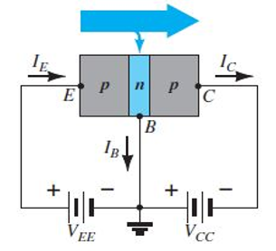
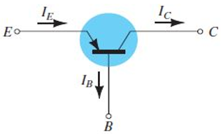
Common Base Configuration
CB Configuration for “pnp” transistor is shown here.
All the current directions are as defined by the choice of conventional flow i.e. all current directions refer to conventional (hole) flow.
Thus, I_{E} = I_{C} + I_{B}
Applied biasing for pnp transistor establishes current in the direction as indicated for each branch. This is confirmed by following: -
Direction of I_{E} with respect to (wrt) polarity of V_{EE} and
the direction of I_{C} wrt polarity of V_{CC}
Notes:
13
13

Slide 14
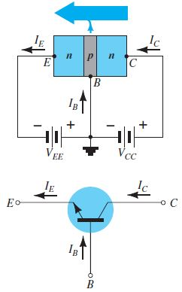
Common Base Configuration
CB Configuration for “npn” transistor is shown here.
All the current directions are as defined by the choice of conventional flow i.e. all current directions refer to conventional (hole) flow.
Thus, I_{E} = I_{C} + I_{B}.
Applied biasing for pnp transistor establishes current in the direction as indicated for each branch. This is confirmed by following
Direction of I_{E} with respect to (wrt) polarity of V_{EE} and
the direction of I_{C} wrt polarity of V_{CC} .
Notes:
14
14

Slide 15
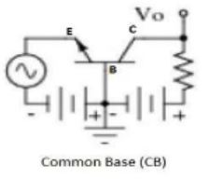
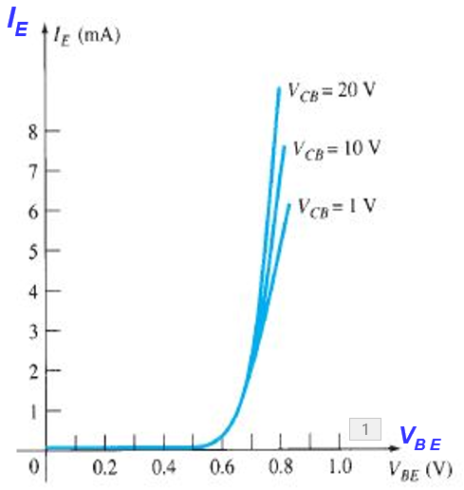
Transistor Performance Characteristics
Following two sets of characteristics define the behavior of a transistor : -
I_{E}
I_{C}
(a) Input or Driving point Characteristics: I_{E} vs V_{BE}
V_{BE}
V_{CB}
(b) Output Characteristics or Collector Characteristics - defined by the parameters of the output side of the circuit. I_{C} vs V_{CB}
Input/Driving Point Characteristics
The input characteristics for the common-base configuration relates an input current (I_{E}) to an input voltage (V_{BE}) for different levels of output voltage (V_{CB}).
For fixed values of collector voltage (V_{CB}), the emitter current increases as the base-to-emitter voltage is increased, in a similar manner to that of diode characteristics.
Increasing levels of V_{CB} have very small effect on the characteristics that can be ignored.
Notes:
15

Slide 16
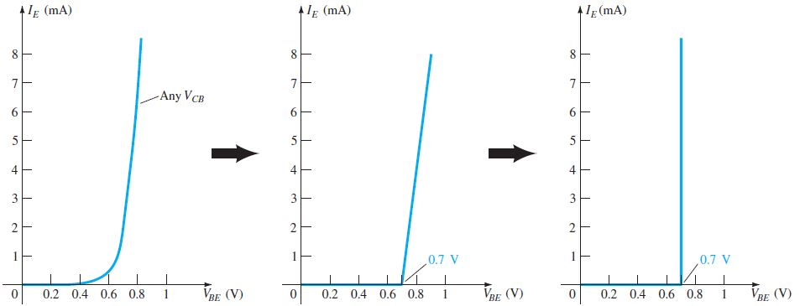
Equivalent Model for B-to-E Region in dc Mode
For fixed value of collector voltage V_{CB} , input characteristics graph of a transistor resembles the diode characteristics. Since, any change in V_{CB} has a very small effect on the emitter current I_{E} , it is ignored to depict the input characteristic graph at Fig A.
Piece-wise linear approach results in graph at Fig B as first approximation.
Second Approximation is to ignore the slope of the curve i.e. ignore the resistance of the forward-biased junction. The characteristics graph reduces to Fig C.
This is used for all dc analysis of transistor networks. This implies that once a transistor is in the “ON” state, the base-to-emitter voltage will be assumed to be V_{BE} = 0.7 V
A
B
C
V_{BE} = 0.7 V
Notes:
16
16

Slide 17
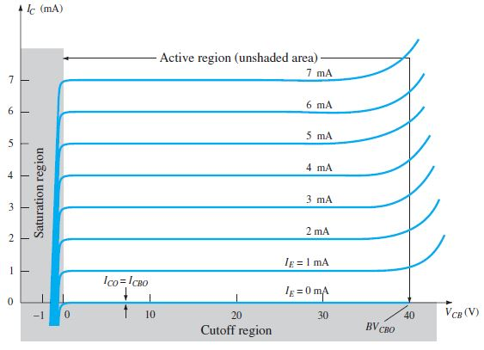
Common Base Output/Collector Characteristics
The output characteristics relate output current (I_{C}) to output voltage (V_{CB} ) for different levels of input current (I_{E} ).
I_{C}
The output or collector characteristics has three basic regions of interest:
I_{E}
Active
Saturation
Cut Off
The active region is normally employed for linear (undistorted) amplifiers.
V_{CB}
Notes:
17
17

Slide 18
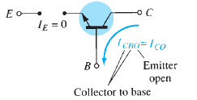
Common Base Output/Collector Characteristics
– Active Region
I_{C}
In Active Region, base–emitter junction is forward-biased, and collector–base junction is reverse-biased.
At the lower end of the active region:
(a) Emitter current (I_{E}) is zero, and
(b) Collector current, which is due to the reverse saturation current I_{CO} ,is of the order of μAs as compared to the vertical scale of the graph for I_{C} (mA), so it appears on horizontal axis as I_{C}= 0.
V_{CB}
Reverse Saturation current I_{CO} is also referred as I_{CBO} (C-to B current with the emitter leg open). Since I_{CO} is very low, it can be ignored.
Notes:
18
18

Slide 19
Common Base Output/Collector Characteristics – Active Region
I_{CBO} , like I_{s} for the diode (both are reverse leakage currents), is temperature sensitive.
I_{C}
At higher temperatures, the effect of I_{CBO} may become an important factor as it increases rapidly with temperature.
As the emitter current increases above zero, the collector current I_{C} also increases and is generally equal to that of the emitter current I_{E}.
V_{CB}
Collector to Base Voltage V_{CB} has a negligible effect on the collector current I_{C} in the active region leading to a conclusion that I_{E} ≈ I_{C} in the active region.
Notes:
19
19

Slide 20
Common Base Output/Collector Characteristics –Saturation Region
I_{C}
Saturation region is to the left of V_{CB} = 0 V, in which the base–emitter and collector–base junctions are forward biased.
Forward bias means that collector (for pnp transistor) region is made positive with respect to base (n-type). This causes hole current to flow from p-side across the collector junction to n-side (base).
Collector current I_{C} increases rapidly with slight increase in collector-base Voltage V_{CB} (for pnp transistor). The collector current may increase to become positive if the forward bias is sufficiently large.
V_{CB}
V_{CB} = 0 V,
Notes:
20
20

Slide 21
Common Base Output/Collector Characteristics – Cut-Off Region
I_{C}
Cut-off Region:
It is region of operation where the base–emitter and collector–base junctions of a transistor are both reverse-biased.
In the Cut-off region, the collector current is 0 A.
V_{CB}
Notes:
21
21

Slide 22
Common Base Output Characteristics - Breakdown Region
As the applied voltage V_{CB} increases, there is a point where the curves take a upswing, which is due to an avalanche effect.
I_{C}
Reason: Base-to-collector junction is reversed biased in the active region, there is a point where too large a reverse-bias voltage will lead to the avalanche effect.
This results a large increase in current for small increase in the base-to-collector voltage.
The largest permissible base-to-collector voltage is labeled as BV_{CBO} or V_{(BR)CBO}. Letter “O” represents that the emitter leg is in the open state.
V_{CB}
Notes:
22
22

Slide 23

Common Base Current Gain α_{dc} (Alpha)
In the DC Mode, the levels of I_{C} and I_{E} are due to the majority carriers, and are related by a quantity called alpha (α), the Common-Base Current Gain
α for all practical devices typically extends from 0.90 to 0.998. It is also referred as α_{dc.}
The thinner and more lightly doped is the base , greater is the value of α_{dc.} However, it cannot exceed unity.
Since alpha α is defined solely for the majority carriers, equation
I_{C} = I_{C majority} + I_{CO minority}
becomes I_{C} = α I_{E} + I_{CBO}
when I_{E} = 0 mA, I_{C} = I_{CBO} , the level of I_{CBO} is so small that it is virtually undetectable on the graph.
So for I_{E} = 0 mA, I_{C} appears to be 0 mA for the different values of V_{CB}.
Current Gain α_{ac} for AC Mode:
For ac situations where the point of operation moves on the characteristic curve, an ac alpha is defined as small change in collector current divided by the corresponding change in I_{E} with the collector-to-base voltage held constant.
α_{ac} = ΔI_{C} / ΔI_{E} with V_{CB} being constant
For most situations the magnitudes of α_{ac} and α_{dc} are quite close.
Notes:
23
23

Slide 24
Common Emitter Configuration
Notes:
24
24

Slide 25
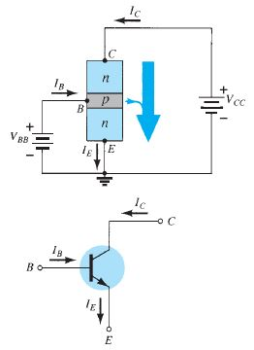
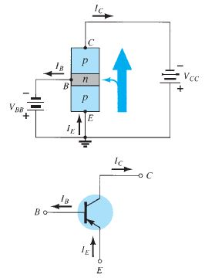
Common Emitter (CE) Configuration
The common-emitter configuration has the emitter common to both the input and output terminals
Two sets of characteristics necessary to describe the behavior of the common-emitter configuration are :
Input or base–emitter circuit and
Output or collector–emitter circuit.
The emitter, collector, and base currents are shown in their actual conventional current direction. Though the transistor is in CE configuration , the currents described for the CB configuration are still applicable. I_{E} = I_{C} + I_{B} and I_{C} = αI_{E}
Notes:
25
25

Slide 26
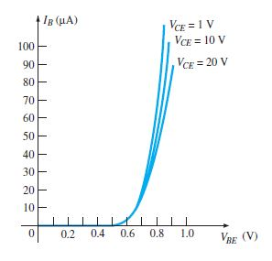
CE Input Characteristics
In the Active Region of a Common-Emitter amplifier, the base–emitter junction is forward-biased, whereas the collector–base junction is reverse-biased.
Similar conditions exist in the active region of the common-base configuration.
The active region of the common-emitter configuration is used for voltage, current, or power amplification.
The input characteristics are a plot of the input current (I_{B}) vs the input voltage (V_{BE}) for a range of values of output voltage (V_{CE}).
Notes:
26
26

Slide 27
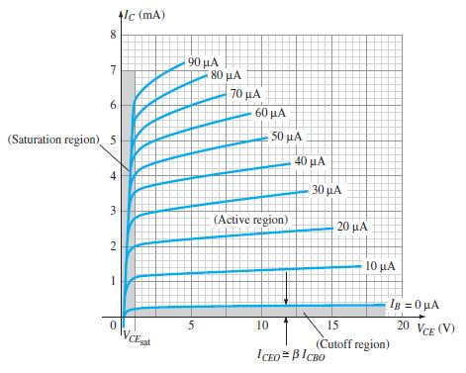
CE Output Characteristics
For the common-emitter configuration the output characteristics are a plot of the output current (I_{C} ) vs output voltage (V_{CE} ) for a range of values of input current (I_{B}).
Magnitude of I_{B} is in μAs as compared to mAs of I_{C} .
Curves of I_{B} are not as horizontal as those obtained for I_{E} in the Common-Base configuration, indicating that the collector-to emitter voltage influences the magnitude of the collector current.
Active region for the CE configuration has the curves for I_{B} that are nearly straight and equally spaced. This region exists to the right of vertical dashed line at V_{CE sat} and above the curve for I_{B} equal to zero. This region is used for for voltage, current, or power amplification.
The region to the left of V_{CEsat} is called the saturation region.
Notes:
27
27

Slide 28
Cutoff Region for CE & CB Configuration
The cutoff region for the CE configuration is not as well defined as for CB configuration. The Figure shows that I_{C} ≠ 0 when I_{B} = 0.
For the CB configuration, when the input current I_{E} = 0, the collector current is equal only to the reverse saturation current I_{CO}. So the curve I_{E} = 0 falls on the voltage axis itself.
Notes:
28
28

Slide 29

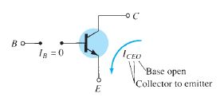


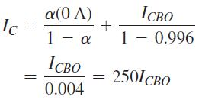

Difference in Characteristics of CB and CE Configuration
Reason for difference in collector characteristics of CB & CE configurations is derived here:
Collector Current
Since, Emitter Current is
(I_{E} = I_{C} + I_{B})
I_{C} can be rewritten as:-
If Base Current is taken as I_{B} = 0 and α = 0.996,
Circuit Condition related to I_{CEO} - Collector to Emitter Current with base open
If I_{CBO} = 1 μA when I_{B} = 0 , this will yield I_{C} = 250 X 1 μA = 0.25 mA
Hence, Collector current defined for the condition
I_{B} = 0 mA is denoted as I_{CEO} for I_{B} = 0 μA
For linear amplification purposes in CE configuration, region below I_{B} = 0 μA should be avoided if an undistorted output signal is required and cut-off for CE configuration is the region defined by I_{C} = I_{CEO}
Notes:
29
29

Slide 30


Beta (ᵝ_{dc}) – Common-Emitter Current Gain
In the DC Mode the levels of I_{C} and I_{B} are related by a quantity called beta called Common-Emitter Current Gain
where I_{C} and I_{B} are determined at a particular operating point on the characteristics. Common-emitter current gain in dc mode is also referred as ᵝ_{dc.}
For practical devices the level of ᵝ_{dc} typically ranges from about 50 to over 400.
Similar to α, the parameter ᵝ_{dc} reveals the relative magnitude of one current with respect to the other. For a device with a ᵝ_{dc} of 200, the collector current is 200 times the magnitude of the base current.
Beta (ᵝ_{ac})
AC Mode: In CE configuration, collector current is the output current and the base current is the input current. There is an associated amplification factor defined ᵝ_{ac} for ac situations and is given by
Hence, ᵝ_{ac} is referred as common-emitter forward-current amplification factor.
Notes:
30
30

Slide 31










Relationship Between Beta & Alpha
Current Gain of a transistor in CE Config
Current Gain of a transistor in CB Config
I_{E} = I_{C} + I_{B}
Solving the equation yields following results:
Or
Solving above equations yields …...Eq-1
Refer Slide 23
Collector current when I_{B} = 0 is given by …..Eq-2
Eq-1 & Eq-2 gives Collector current I_{CEO} = ( β +1). I_{CBO}
I_{CEO} = β . I_{CBO} (I_{CBO} being small)
Beta provides a direct link between current levels of the input
and output circuits for a CE configuration I_{C} = β.I_{B}
and I_{E} = I_{C} + I_{B}
I_{E} = β I_{B} + I_{B}
I_{E} = (β + 1) I_{B}
Notes:
31
31

Slide 32
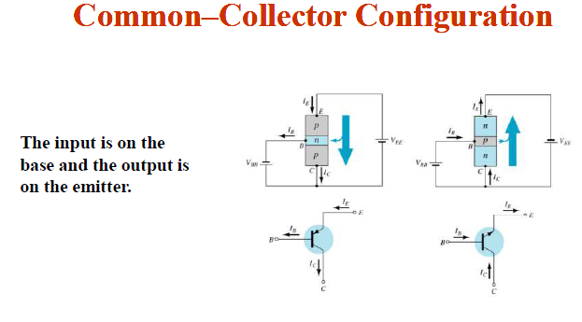

Slide 33
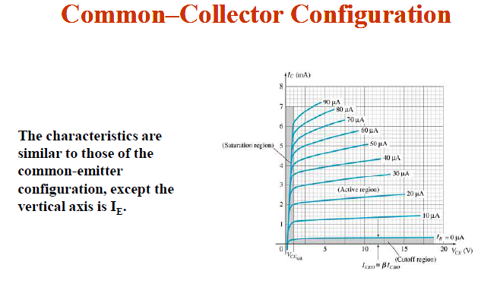

Slide 34
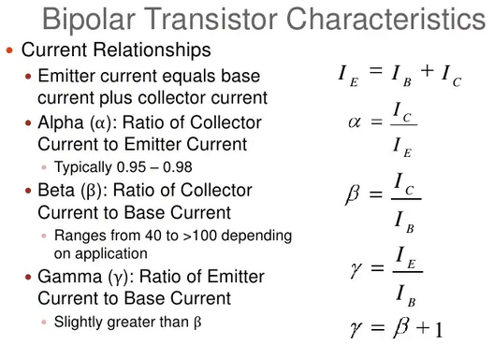

Slide 35
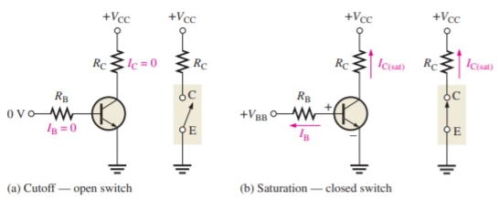
BJT as a Switch

Slide 36
BJT Biasing
Fixed Biasing
Notes:
36

Slide 37
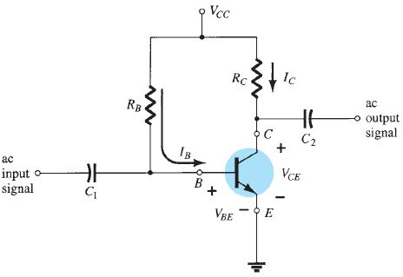
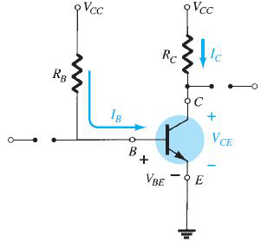
BJT Biasing - Fixed Bias Configuration
This is the simplest transistor dc bias configuration. The equations and calculations are applicable to both types of transistors (npn & pnp) merely by changing current directions and voltage polarities.
The current directions are as shown.
For the dc analysis, the network can be isolated from the indicated ac levels by replacing the capacitors with an open-circuit equivalent, because the reactance of a capacitor is infinity for dc.
For analysis, the dc supply V_{CC} can be separated into two supplies to separate input and output circuits. It also reduces the linkage between the two to the base current I_{B} .
Notes:
37

Slide 38
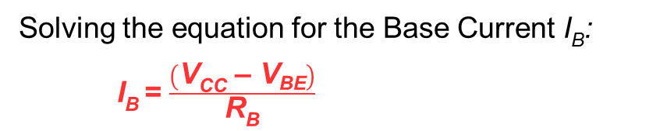
BJT Biasing - Fixed Bias Configuration
Forward Bias of Base-Emitter
Consider the base–emitter circuit loop first, the Kirchhoff’s voltage equation in the clockwise direction for the loop gives
+V_{CC} - I_{B}R_{B} - V_{BE} = 0
I_{B}R_{B} = V_{CC} - V_{BE}
Supply voltage V_{CC} and the base–emitter voltage V_{BE} are constants, the selection of a base resistor R_{B} sets the level of base current for the operating point.
Notes:
38

Slide 39
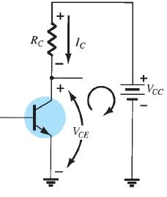
BJT Biasing - Fixed Bias Configuration
Collector-Emitter Loop
Collector–emitter section of the network shows the direction of current I_{C} and the resulting polarity across R_{C} .
Magnitude of the collector current is related directly to I_{B} through I_{C} = ᵝ I_{B}
Base Current I_{B} is controlled by R_{B} and Collector Current I_{C} is related to I_{B} by a constant ᵝ.
Magnitude of I_{C} is not a function of the resistance R_{C} . Changing R_{C} to any level will not affect the level of I_{C} in the active region of the device.
Value of R_{C} will determine the magnitude of V_{CE ,} as worked out by applying Kirchhoff’s voltage law:
V_{CE} = V_{CC} - I_{C}R_{C}
Notes:
39

Slide 40
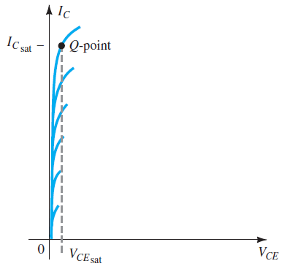
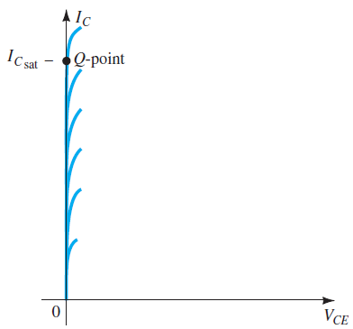
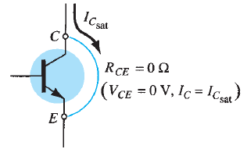

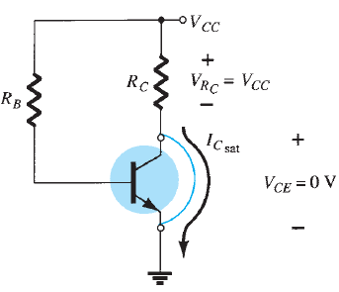

Transistor Saturation
Saturation for a transistor occurs when collector current for a specific design has reached its maximum value. On changing the design, the saturation level may rise or drop. Highest saturation level is a limit provided by the manufacturer.
Fig-A
Fig-B
In an amplifier, saturation state is avoided as the base–collector junction is no longer reverse-biased and the output signal gets distorted. Fig-A and B show the Operating point-Q in the saturation region.
Fig-C
While in saturation, the collector-to-emitter voltage is at or below V_{CEsat}. Fig-B shows that current is relatively high, and the voltage V_{CE} is assumed to be 0 V. Applying Ohm’s law, resistance between collector and emitter terminals can be determined:
Applying the above result to the network shown in Fig-C, as R_{CE} =0, V_{CE} will also become zero while I_{Csat} will be the current.
Fig-D
Thus for the fixed-bias configuration of Fig-D , I_{Csat} can be obtained by shorting C & E terminals:

